Slide 1

COLLEGE OF NATURAL AND COMPUTATIONAL SCIENCE DEPARTMENT OF COMPUTER SCIENCE
FOOD DELIVERY ANDROID APPLICATION CoSc4411_: FINAL PROJECT

Slide 2
Outline
CHAPTER TWO
REQUIREMENT ANALYSIS
Introduction
Current system
Problems in the existed system
Requirements gathering
Proposed system
System Models
dynamic modelling
User Interface

Slide 3
REQUIREMENT ANALYSIS
Introduction
Online food ordering system solves problems between customers and restaurant owners
Creates a sales channel for restaurants, reducing labor cost and required space
Enables restaurants to organize and generate more profits, bypassing competition and getting closer to customers
Beneficial for food aggregators or marketplaces as a hub for various restaurants to share and post food outlets

Slide 4
Cont…
Simplifies the process of receiving orders, eliminates human errors and long delivery times, and saves time for customers
Customers can browse menu items, choose preferences, and make payments through the app
Restaurant prepares and delivers food to specified location
Enables restaurants to reach a larger customer base without requiring physical establishment presence.

Slide 5
Current system
Current system for food delivery in Addis Ababa:
Most restaurants have no online delivery system.
Customers can either go to the restaurant or call to check menus and order.
There is no way to know the available food and drinks at a specific restaurant.
Customers have no knowledge of restaurants around, and randomly choose where to go.

Slide 6
Problems in the existed system
The traditional system of placing orders via phone calls or in-person at restaurants can be cumbersome for customers and cause several problems:
Orders may not be prepared or ready for pickup upon arrival, causing frustration for customers with tight schedules.
There is a chance of orders being mixed up, even if they are expressed explicitly over the phone, especially during peak hours.
Customers may have trouble getting through to the restaurant to place their orders, resulting in missed sales.
Answering orders can take up staff time, creating a near full-time job and distracting from other restaurant tasks.

Slide 7
Requirements Gathering
Requirements gathering methodology:
Observation of current system
Interviews with restaurant owners and customers
Review of existing systems and user comments
Results found:
Current system is troublesome, not efficient or accurate
Not organized and time-consuming for both sides
No way to ensure correct order placement and no mixing of orders
Overwhelming phone calls from customers can lead to poor response
Requires large labor forces and spaces to run the system.

Slide 8
Proposed system
Functional requirements
For customers:
Login
Choose restaurant and navigate menu
Select and customize items
Review and modify current order
Provide delivery and payment details
Place and confirm order

Slide 9
Cont…
For app owner:
Add/update/delete vendors from menu
For restaurants:
Add/update/delete food categories
Add/update/delete options for items
Update prices and default options
Update additional information for items.

Slide 10
Non-Functional requirement
Non-functional requirements are qualities that are not directly related to the functional behavior of the system but instead describe its performance and user experience.
In the context of a food delivery app, some examples of non-functional requirements are
performance, scalability, security, compatibility, usability, maintainability, reliability, and compliance.
User interface and human factors refer to the design and ease of use of the app, while documentation specifies the requirements and agreement between involved parties.

Slide 11
Cont…
Hardware consideration covers the necessary device specifications, such as processor, memory, GPS, camera, battery life, durability, network connectivity, and screen size.
Performance characteristics refer to the app's speed, reliability, ease of use, security, real-time tracking, push notifications, scalability, and so on.
Error handling and extreme conditions include frontend and backend error handling, notification service error handling, and system responses to offline processing, low latency, real-time data updates, network failure, and automated testing.

Slide 12
System modification
Modify app to offer additional features for customers:Allow customers to schedule deliveries in advance
Implement a loyalty program to reward repeat orders
Offer customized meal plans based on dietary preferences/restrictions
Enable real-time order tracking via notifications
Allow customers to rate and review restaurants and dishes
Integrate automated payment systems (e.g., Apple Pay, PayPal) to simplify payments

Slide 13
System Models
Use Case model:
Use Case Model: A technique for capturing functional requirements of a system by describing typical interactions between users and the system.
Use Case Diagram: Captures the dynamic aspect of the system by representing the user's interaction with the system and showing the relationship between the user and the different use cases involved. See Figure 2-1 for an example.

Slide 14
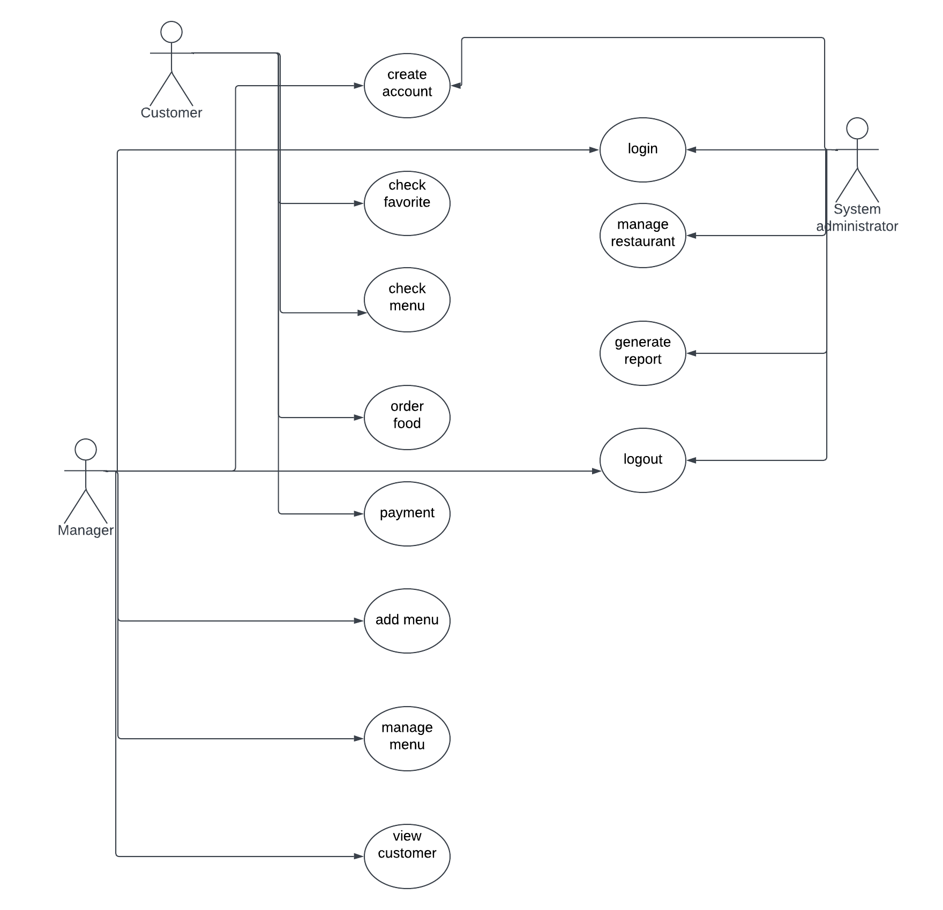
Cont…

Slide 15
Class diagram
A class diagram is a unified modelling language that describes the structure of the system by showing the system’s class, their attributes, operations and the relationships among objects

Slide 16
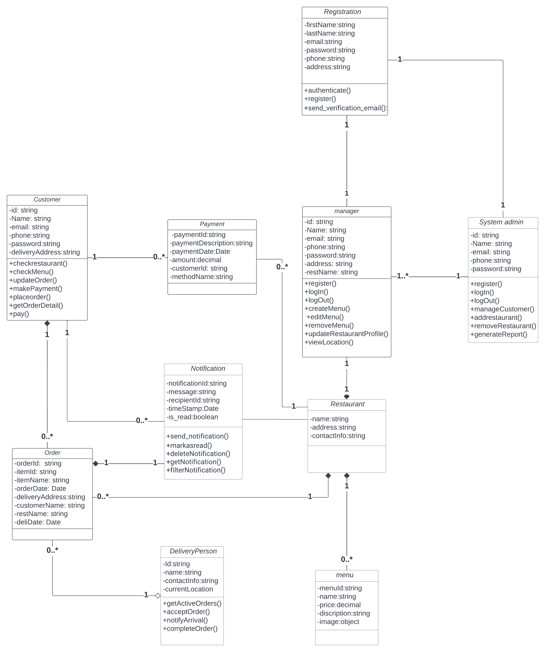
Cont…

Slide 17
Sequence diagram
Sequence diagram: interaction diagram showing object interactions in time sequence
Depicts objects and classes involved in the scenario
Shows sequence of messages exchanged between objects to carry out scenario functionality
Typically associated with use case realizations

Slide 18
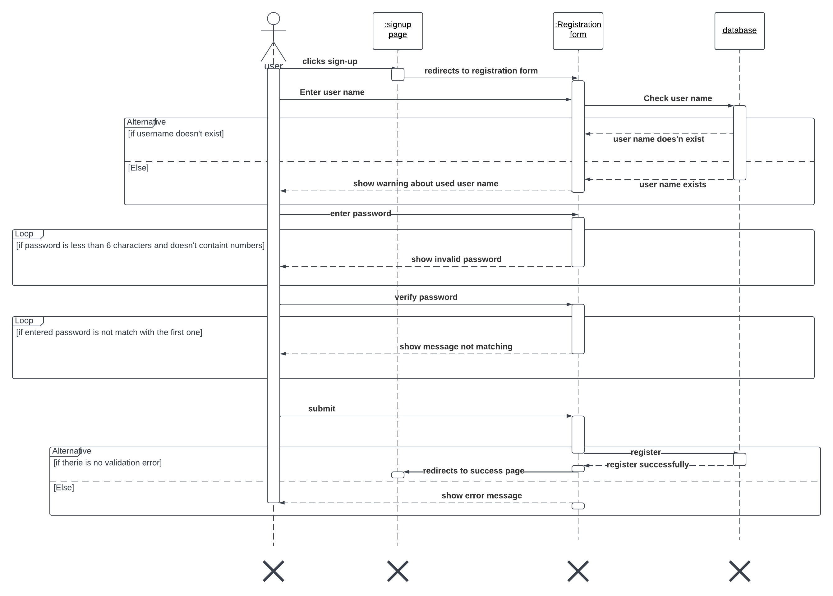
Create account

Slide 19
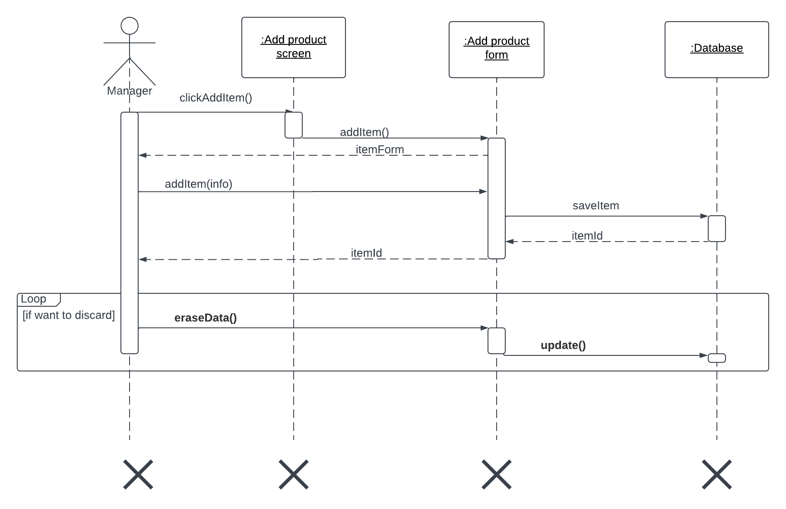
Add item

Slide 20
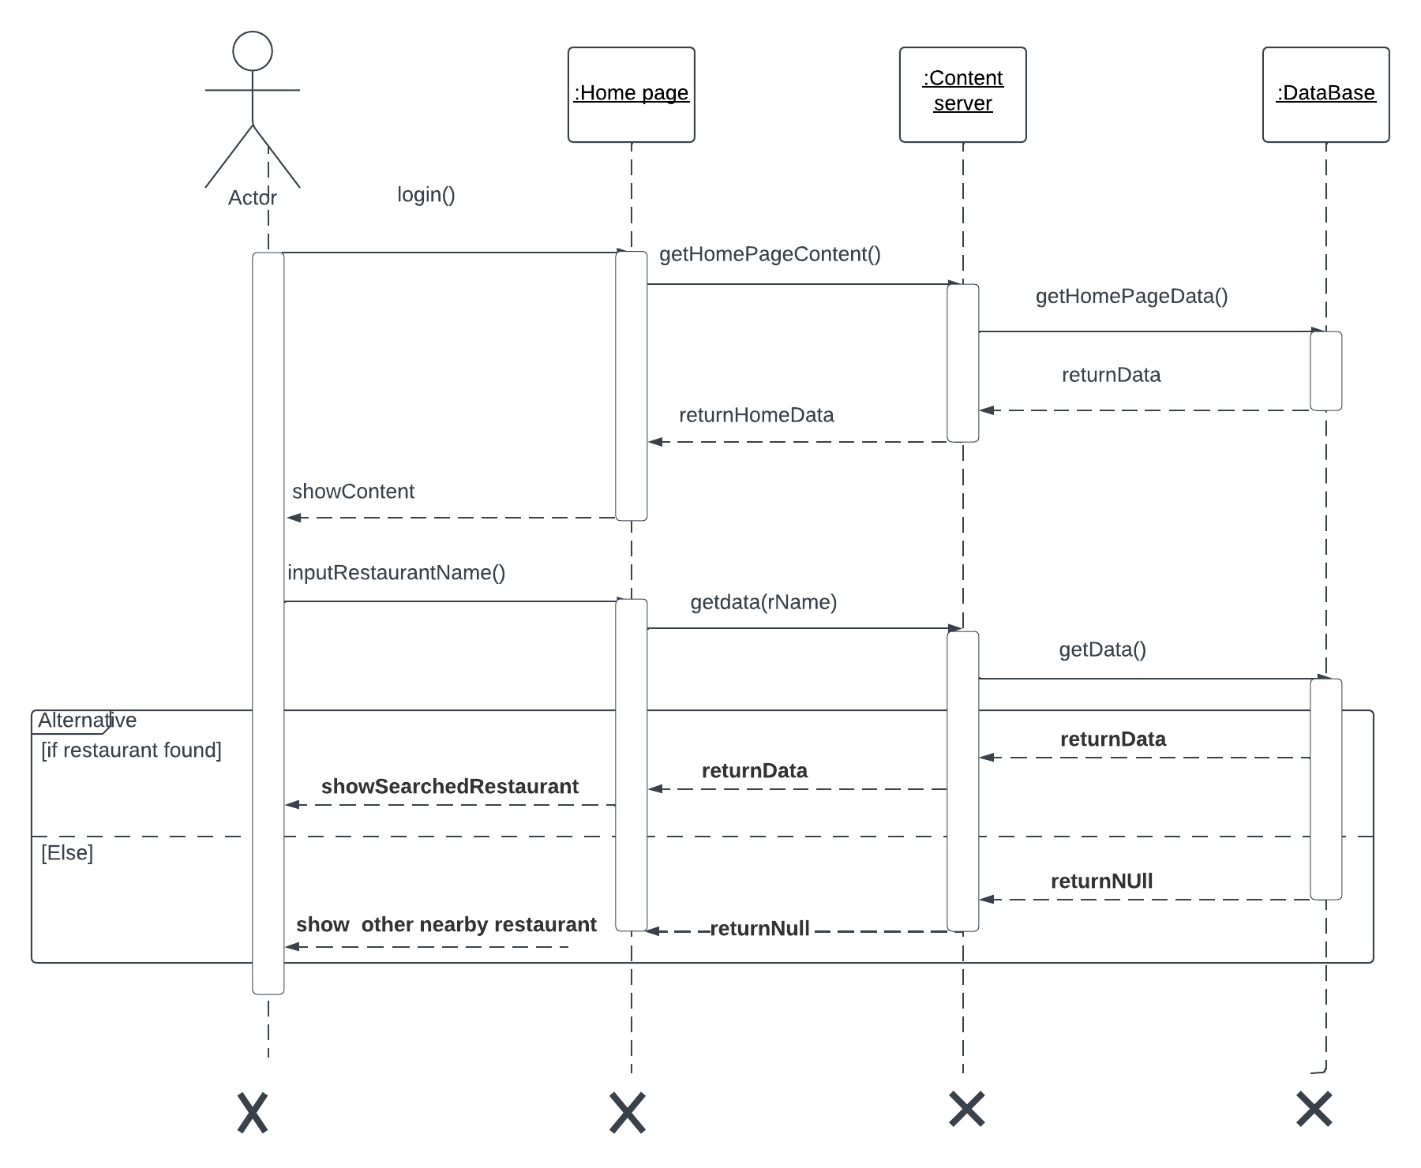
Search Restaurant

Slide 21
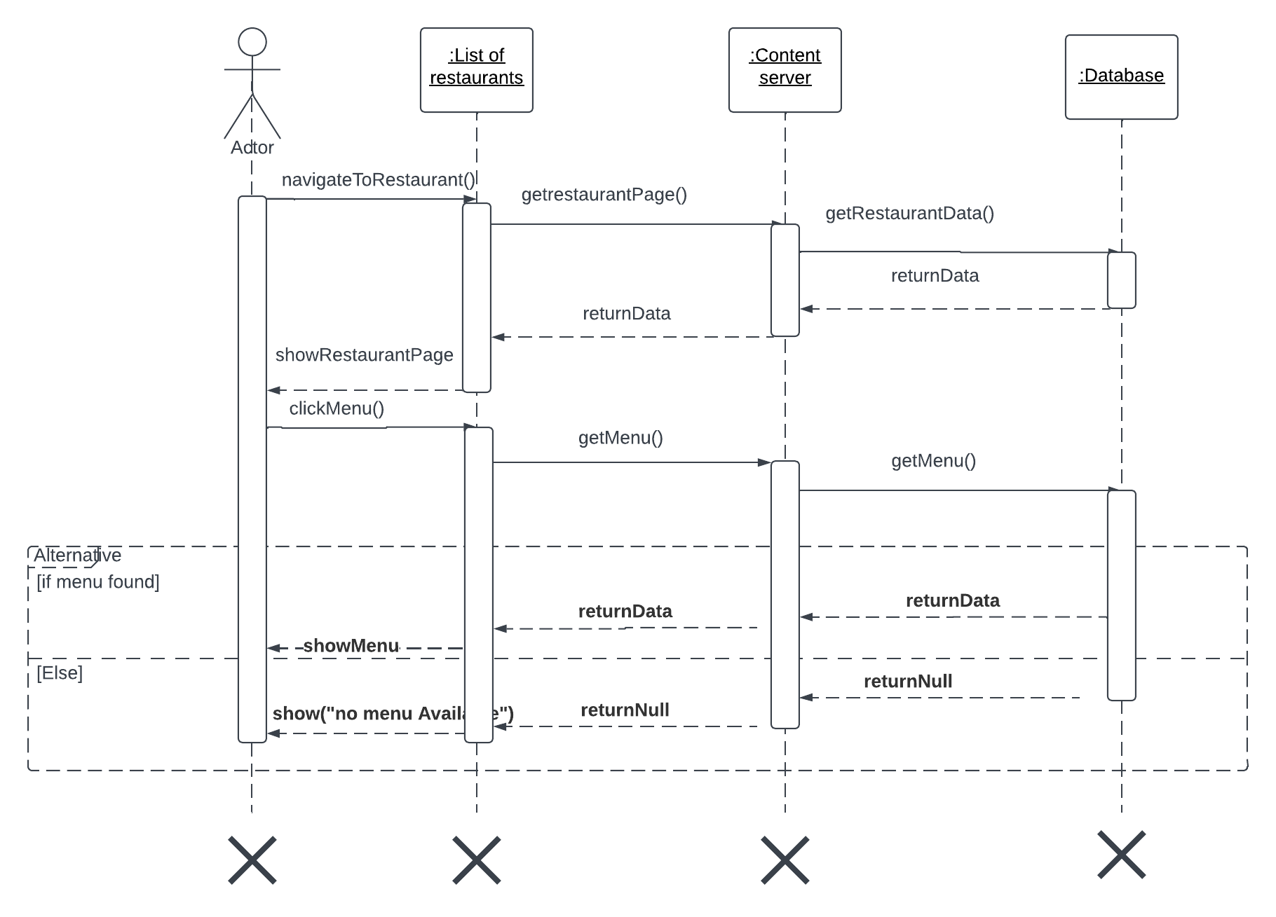
Check menu

Slide 22
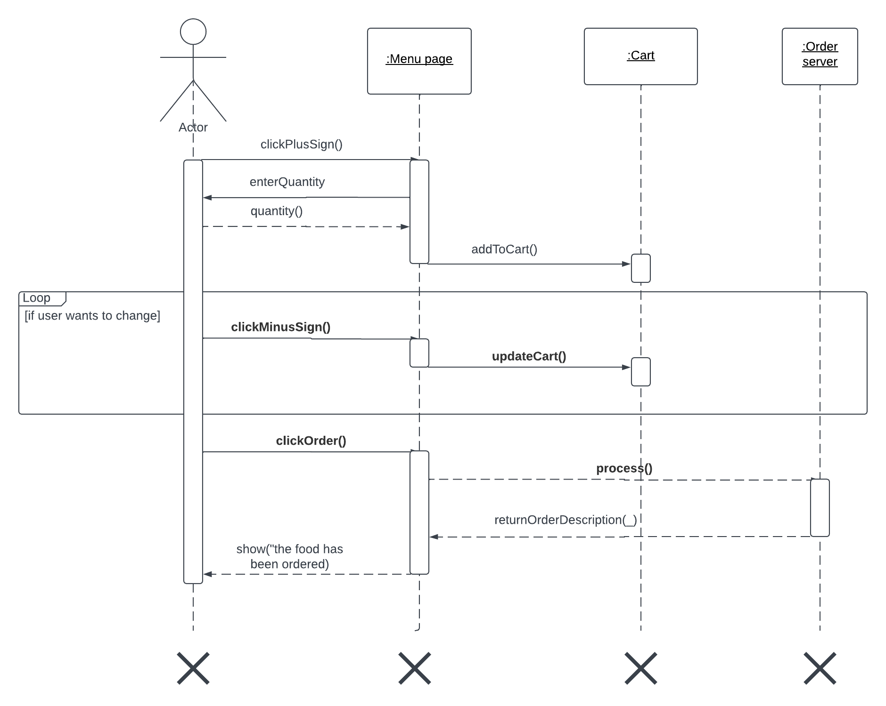
Order

Slide 23
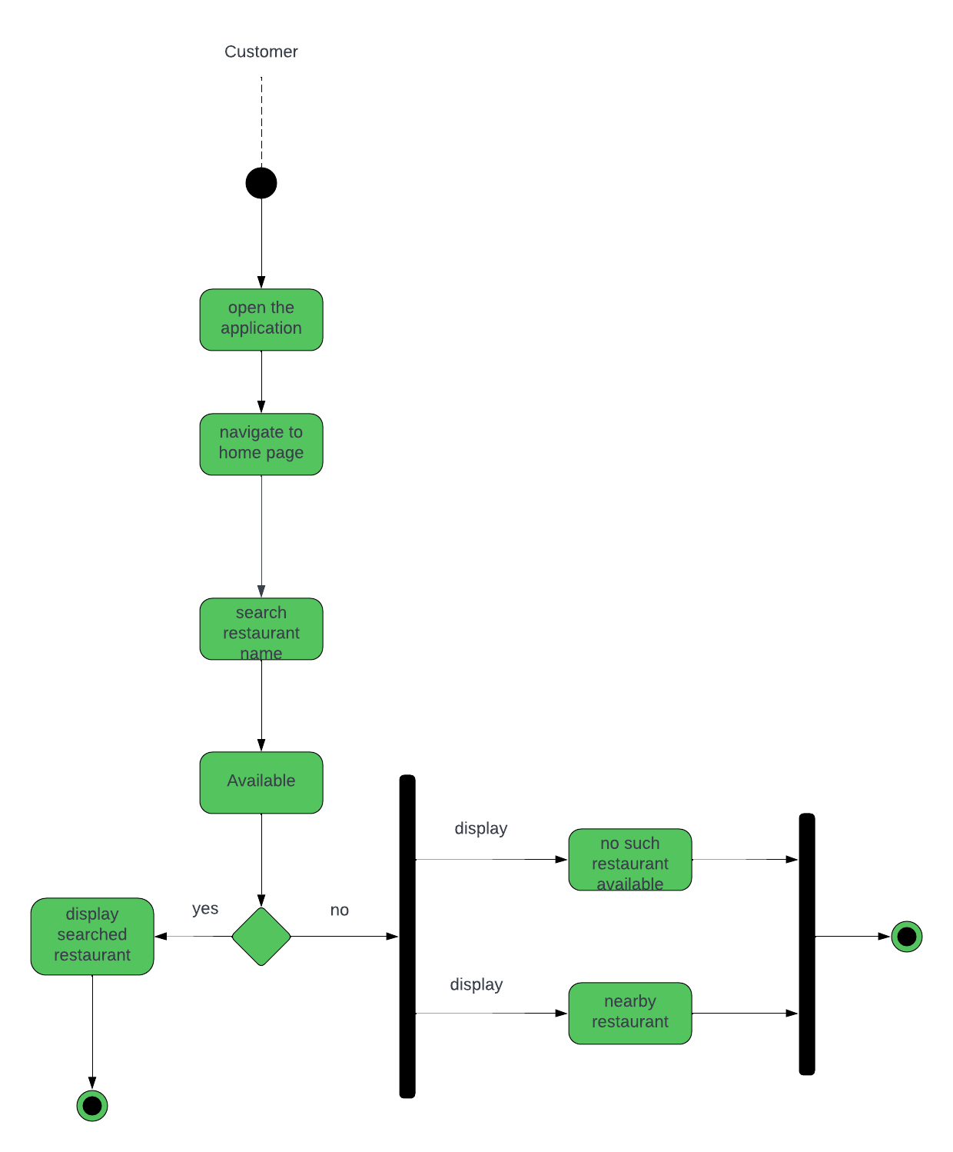
search restaurant

Slide 24
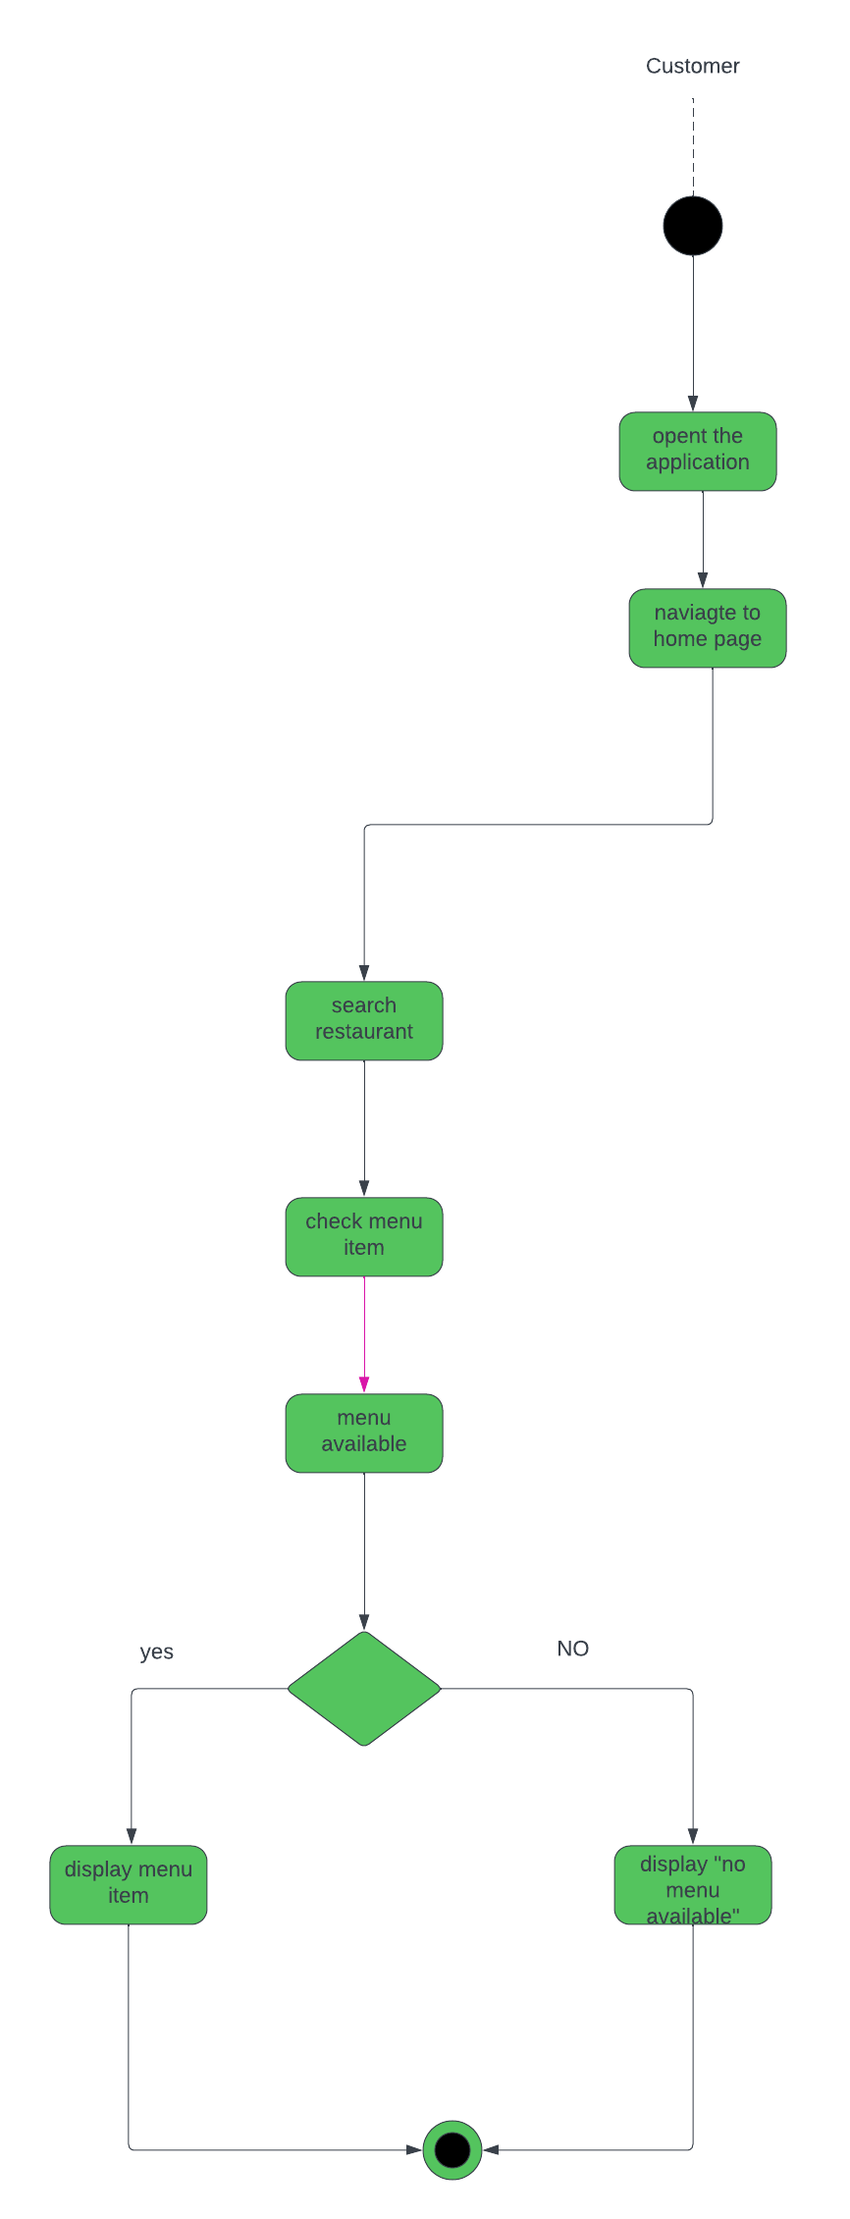
check menu

Slide 25
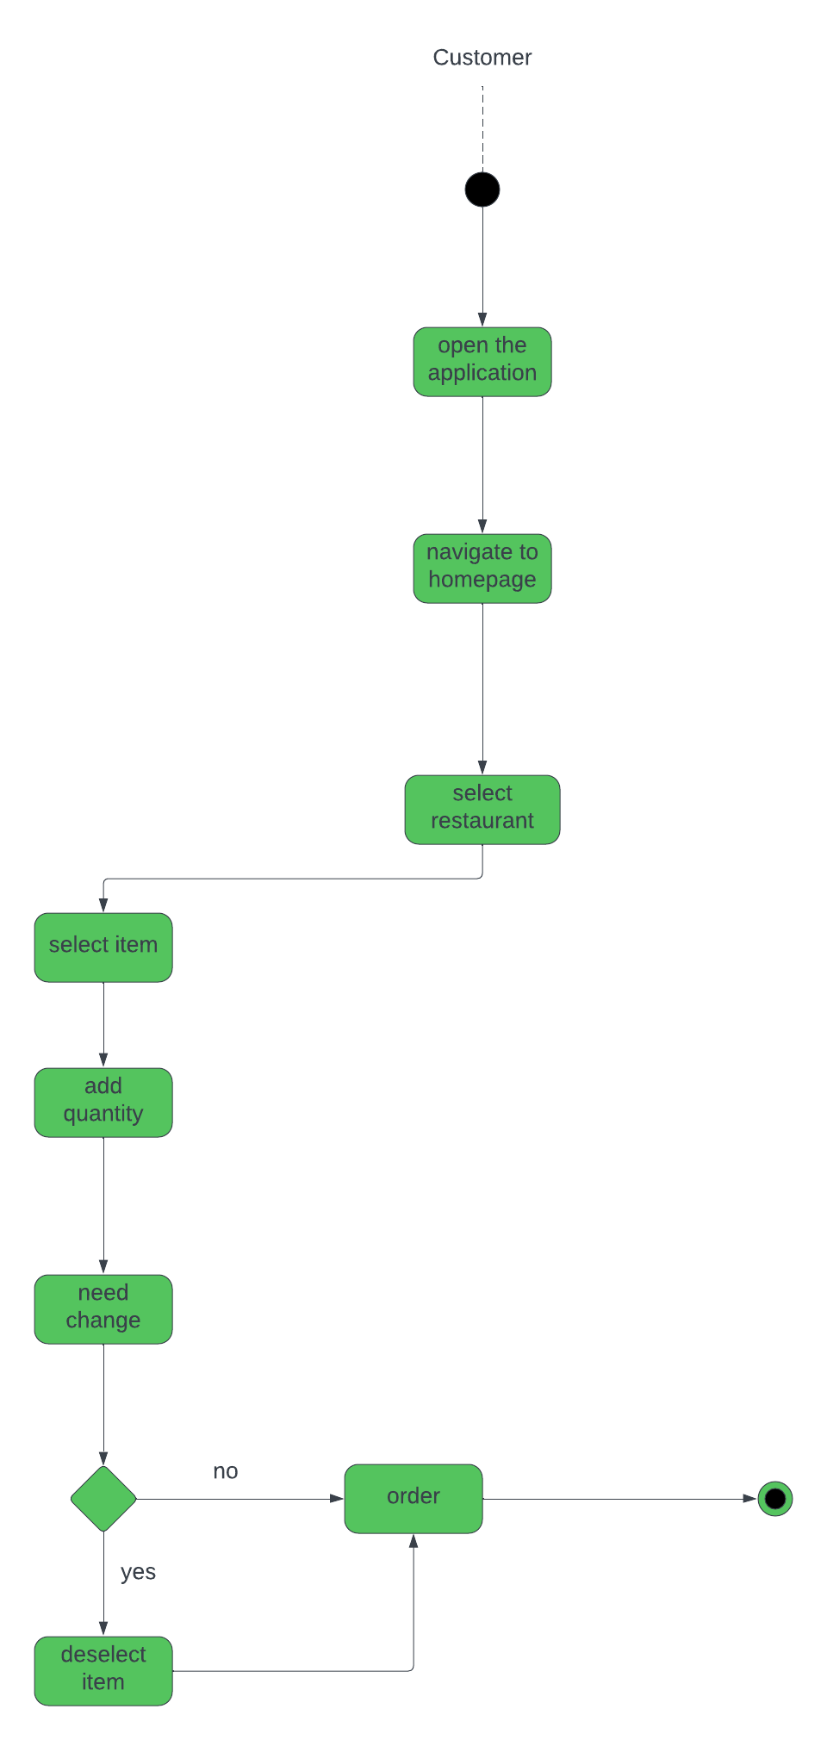
order

Slide 26
Top Cuisines Page Interface

